Slide 1
STEP PRESENTATION
SHERIN STANLEY

Slide 2
OBJECTIVE
TO FIND RELATION BETWEEN THE FOLLOWING FIELDS
  TARGET: Client with payment difficulties denoted as 1 , otherwise 0
  NAME_CONTRACT_TYPE :Specifies if loan is cash or revolving
  CODE_GENDER:Gender of the client
  FLAG_OWN_CAR:Flag if the client owns a car
  FLAG_OWN_REALTY:Flag if client owns a house or flat
  CNT_CHILDREN:Number of children the client has
  AMT_INCOME_TOTAL:Income of the client
  AMT_CREDIT:Credit amount of the loan

Slide 3
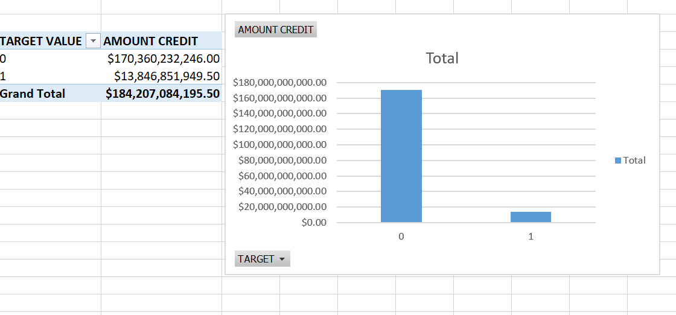
TARGET
V
S AMT_CRDITED
It is clear that people with less amount credited fails to pay the amount on time

Slide 4
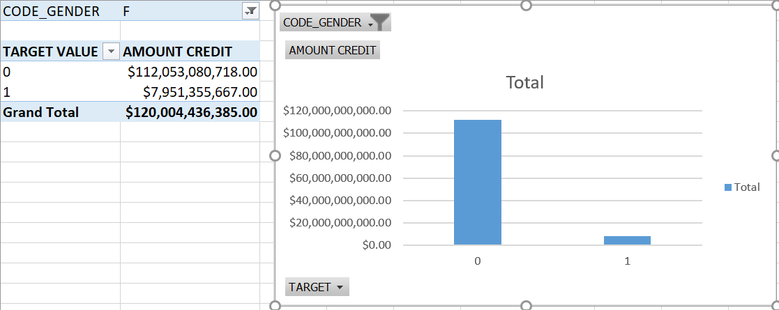
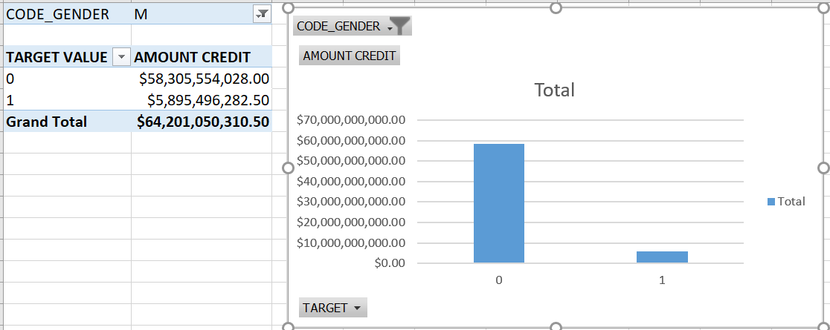
TARGET VS AMT_CRDITED based on gender
FEMALE CUSTOMERS
MALE CUSTOMERS

Slide 5
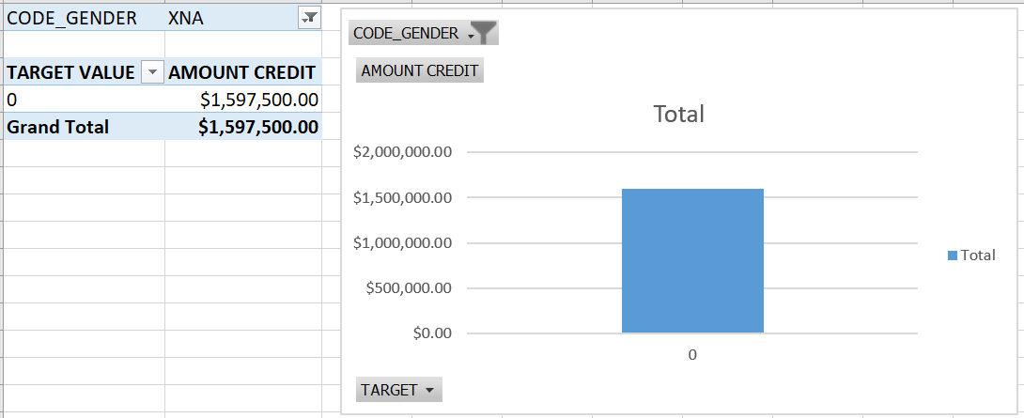
TARGET VS AMT_CRDITED based on gender(cont…)
OTHER GENDER
REVIEW
Based on the analysis it is clear that,late payment(target value=1) is higher for female customers

Slide 6
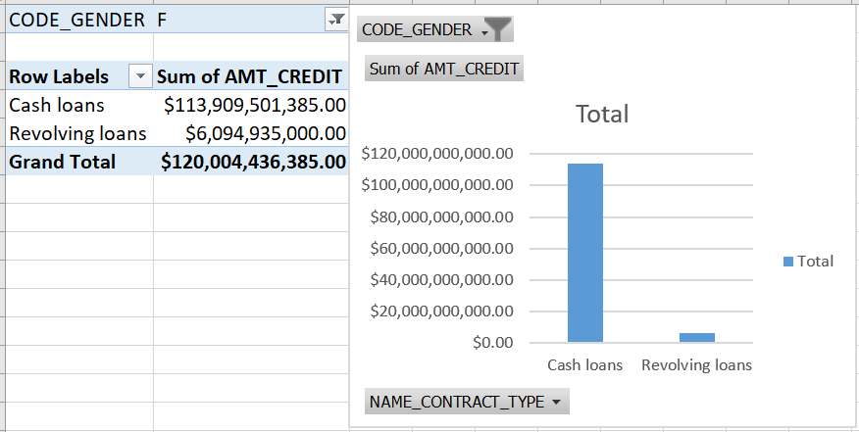
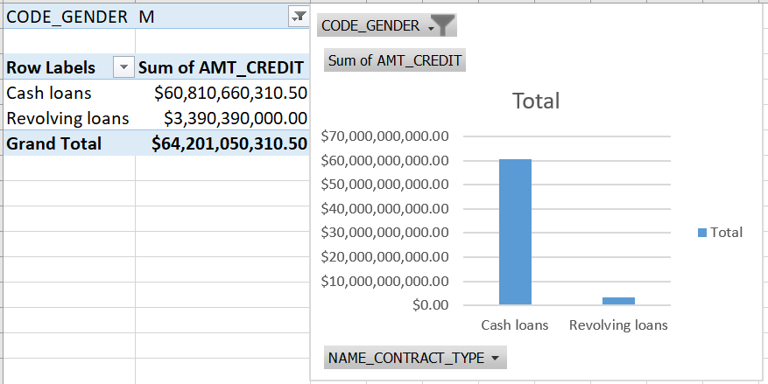
Contract type vs amount credited BASED ON GENDER
FEMALE CUSTOMERS
MALE CUSTOMERS

Slide 7
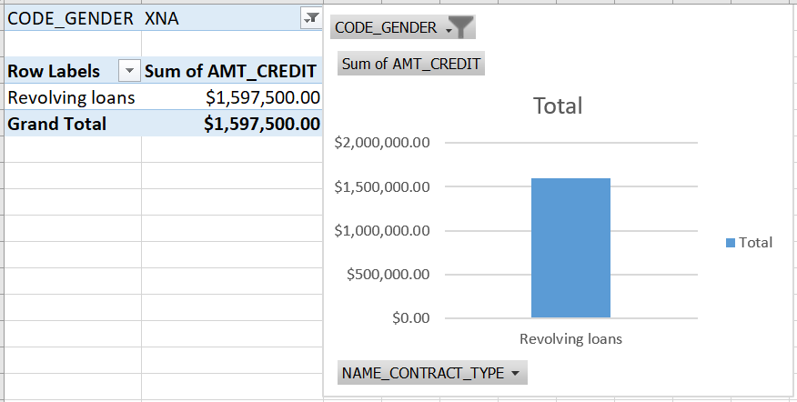
Contract type vs amount credited BASED ON GENDER (CONT…)
OTHER GENDER
REVIEW
In general, cashloans and higher that Revolving loans, meanwhile amount credited is higher for females than other gender values.

Slide 8
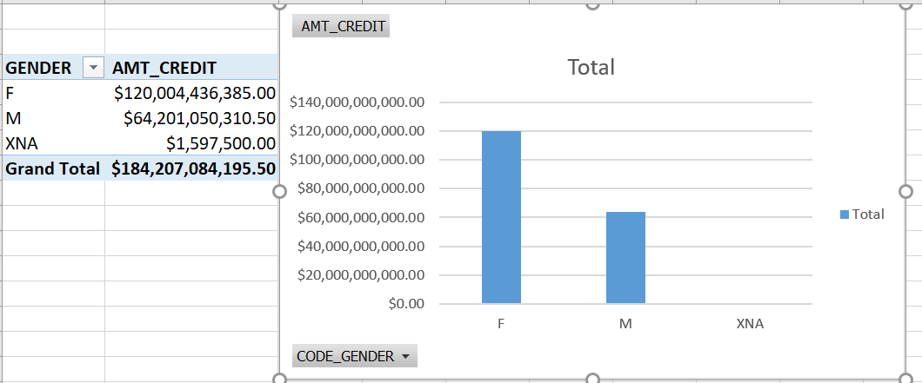
AMOUNT CREDITED BASED ON GENDER
It seems that females are more likely to credit higher amount than males

Slide 9
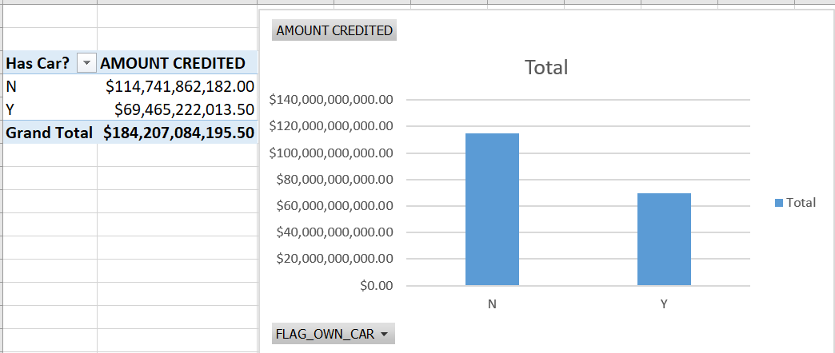
AMOUNT CREDITED BASED ON OWNERSHIP OF CAR
It seems that higher rate of amount credited for customers who has no car owned

Slide 10
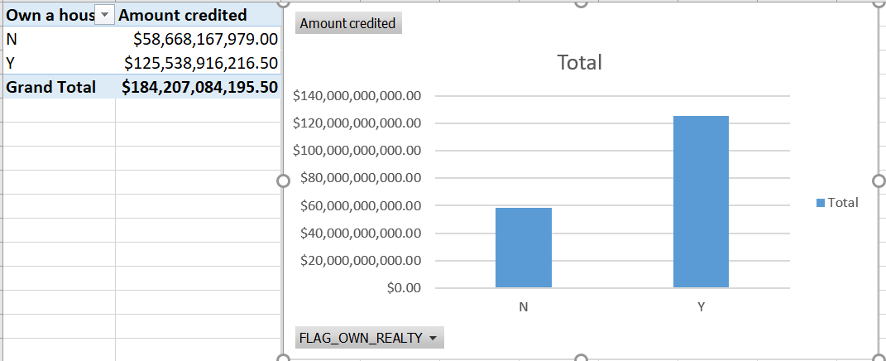
AMOUNT CREDITED FOR CLIENTS WITH OWN HOUSE/FLAT
It seems that , clients with own house/ flats are likely to have more amount of credit amount than those who do not have.

Slide 11
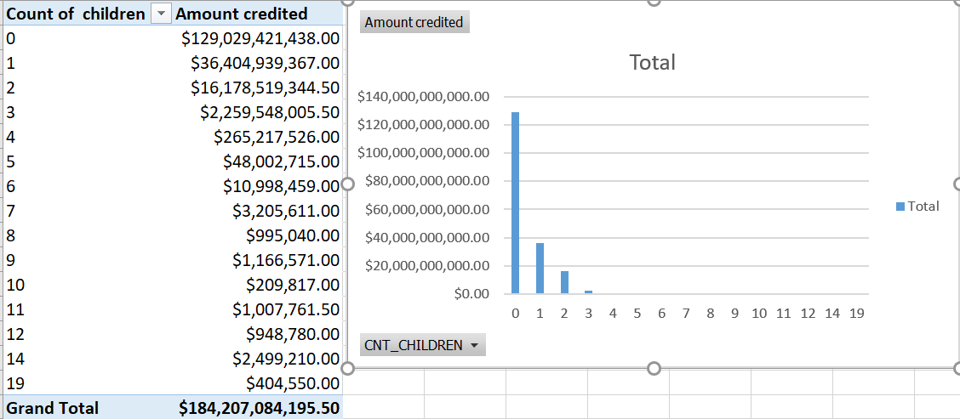
Based on number of children
With less number of children, amount credited is increasing, ie, When number of children increases , amount will decrease.

Slide 12
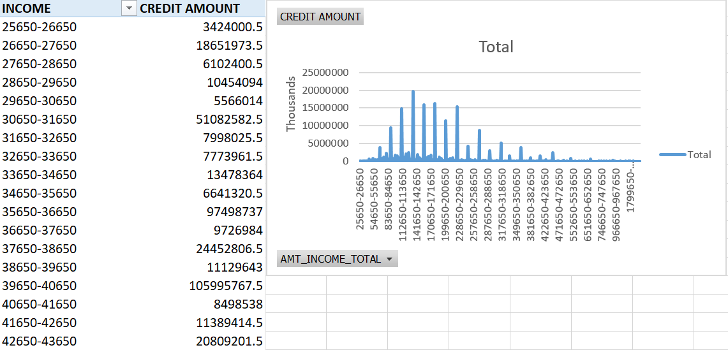
From the chart, it is clear that client with higher income has a chance to credit more amount.

Slide 13
Inferences…
Clients with good financial background and less liabilities have more chances to get higher amount of credit amount
It is likely that females are more likely to fail on repayment on time

